Slide 1
System Miami 04 Oct 2024

Slide 2
Art Updates
Spritesheets,
Intersection Prefabs

Slide 3
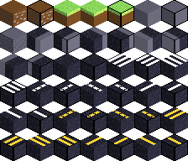
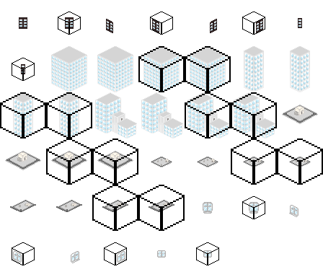





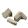


DownTown spritesheets

Slide 4
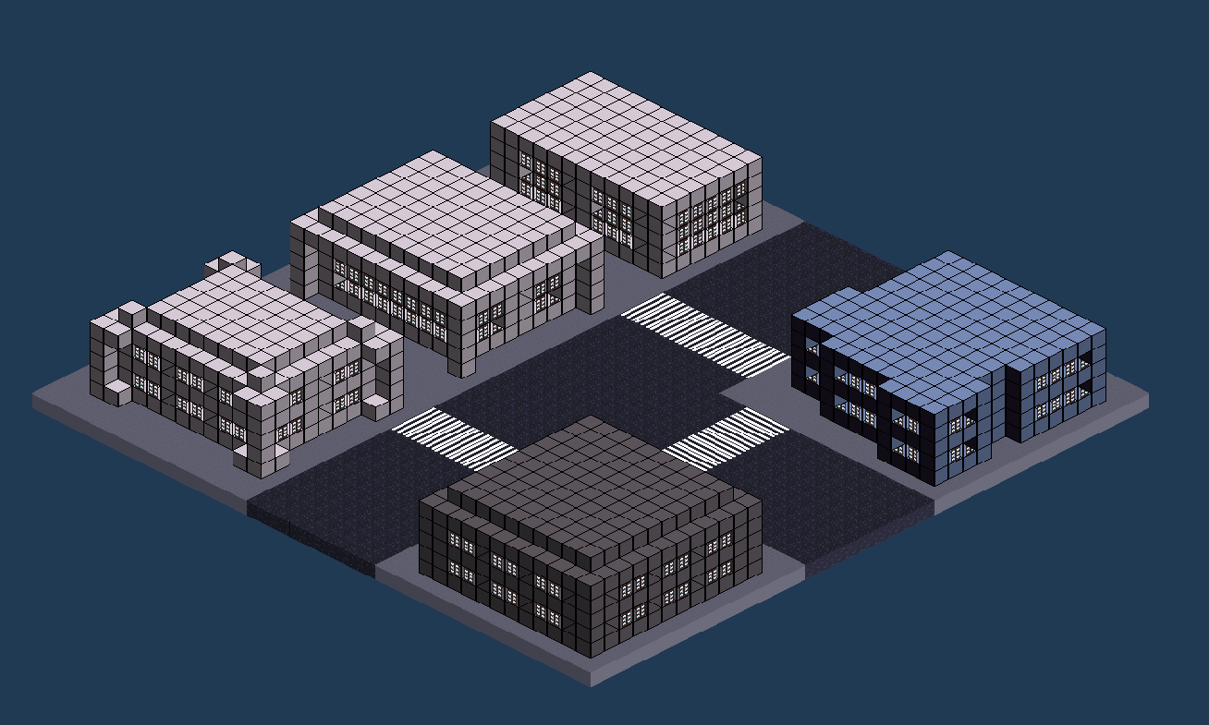

Slide 5
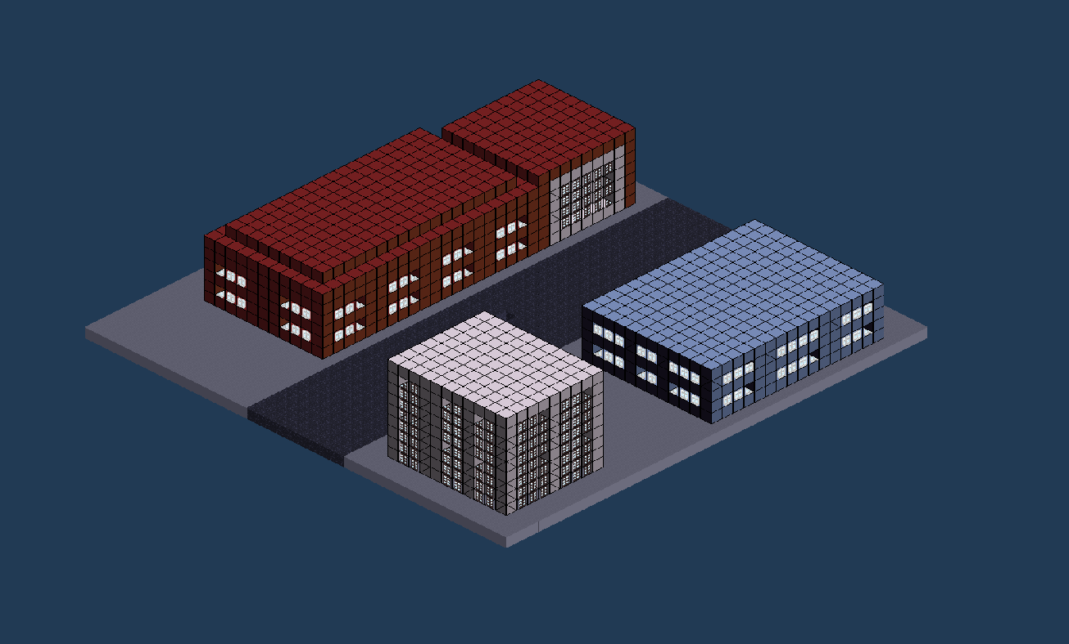

Slide 6
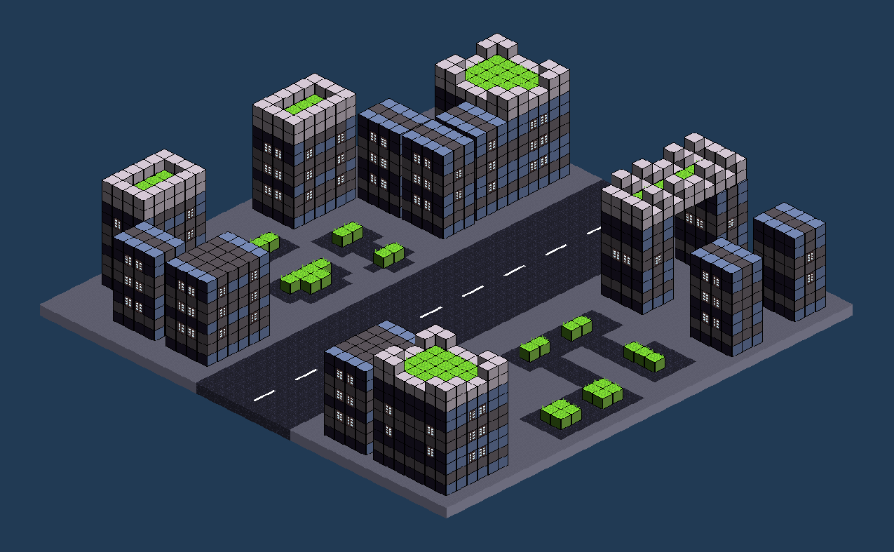

Slide 7
Development Updates
Player Movement, Attributes + Stats

Slide 8
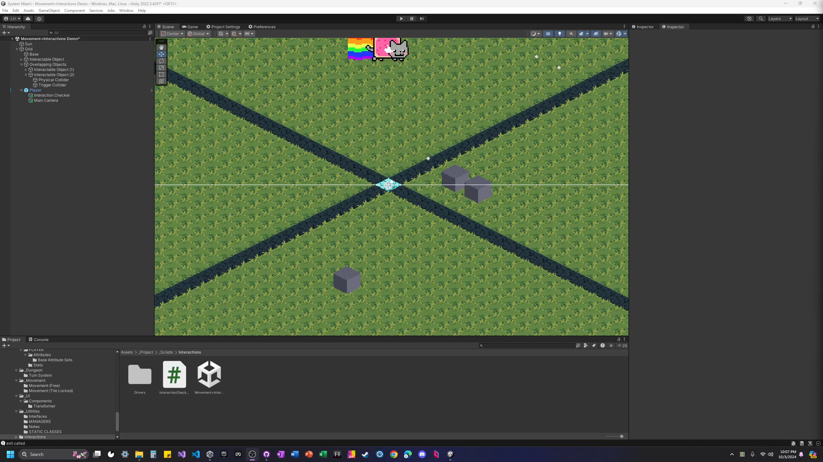
Movement (Overworld) + Simple Interactions

Slide 9
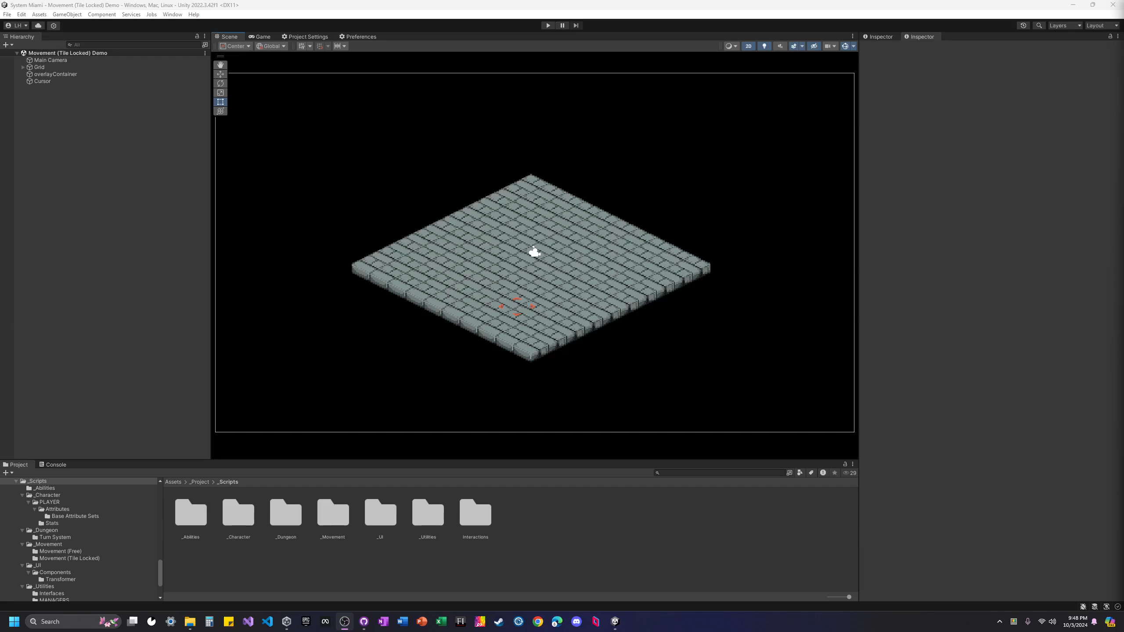
Movement (Dungeon / Combat)

Slide 10
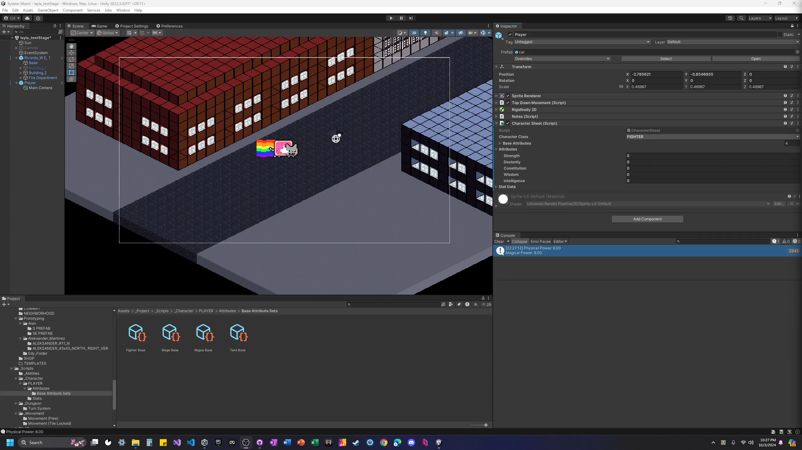
Character Sheet
Character class determines starting attributes at runtime
Stats formulas plug in attributes to determine Character’s Stats

